Slide 1




KIA/Hyundai CAR Theft analysis

Slide 2
4 TIMES MORE places with more theft vs. places with less theft
Counties seen >2.5 times more theft
Count of locations with more theft | 423
Median Percentage of more car theft | 57%
Count of locations with less theft | 101
Median Percentage of improvement | 15%

Slide 3
Ohio seen 60 times more Kia/Hyundai from 2019 to 2022
6801
2446
1315
576
41
134

Slide 4
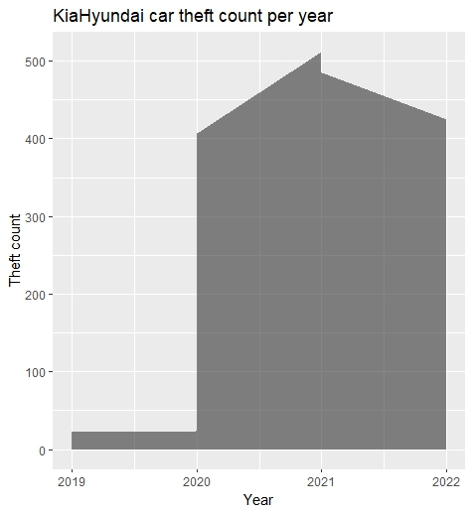
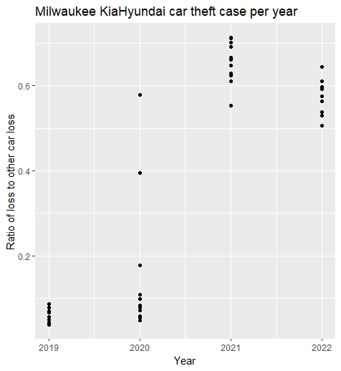
Milwaukee: a sudden jump of Kia/Hyundai car theft in Covid time (2020-2022)

Slide 5
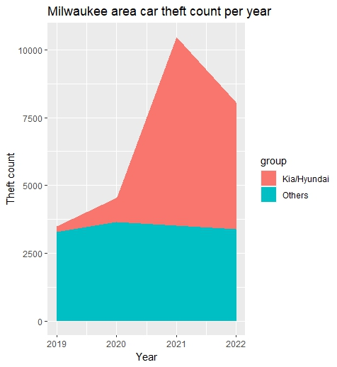
Milwaukee area Kia/Hyundai car theft increased way more than other brand car theft
Other brands | 1.4 times
Kia/Hyundai | 22.6 times

Slide 6
Call of actions:
KIA / HYUNDAI:
Add Anti-Theft devices
to your car!!

Slide 7
Backup
Data source for the charts:
Pie charts: carTheftMaps.xlsx
Stacked bar chart: KiaHyundaiThefts.xlsx
Area Chart & Stacked Area chart: KiaHundaiMilwaukeeData.xlsx
Data source used in the R files:
CarTheftmap.R: carTheftMaps.xlsx
KiaHyundaiThefts.R: KiaHyundaiThefts.xlsx
Milwaukee-theft.R: KiaHundaiMilwaukeeData.xlsx

